Slide 1
Gradient Descent
By Nick Koehler, Juan Kim, and Cindy Li

Slide 2
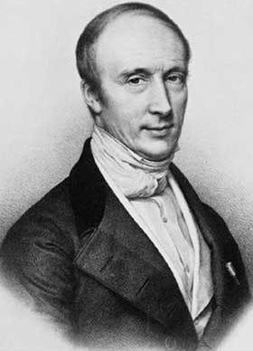
gradient descent in history
Pavel Alexeevich Nekrasov in 1822—Used this method in more general cases
Augustin-Louis Cauchy in 1847–First brought up
Jacques Hadamard in 1907—First proposed similar
Notes:
https://www.sciencedirect.com/science/article/pii/S0315086096921461
Augustin-Louis Cauchy was a French mathematician and physicist who made pioneering contributions to mathematical analysis. Motivated by the need to solve “large” quadratic problems (6 variables) that arise in Astronomy, he invented the method of gradient descent. Today, this method is used to comfortably solve a problems with thousands of variables.

Slide 3
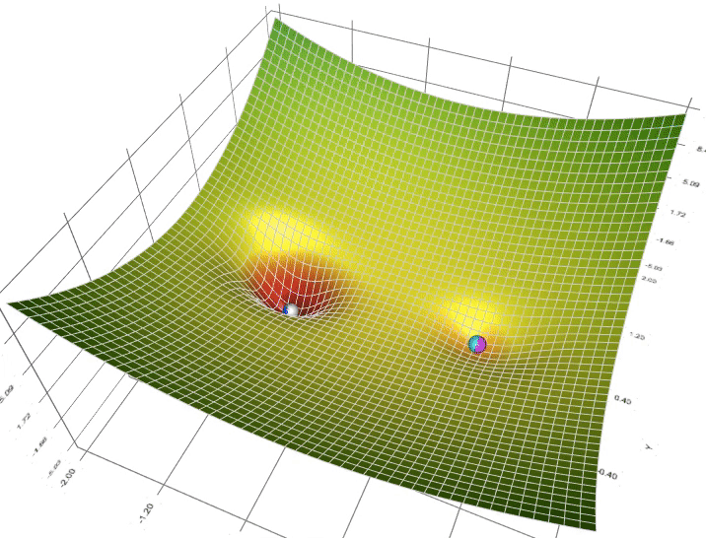
Overview of Gradient descent
Iterative
Convergence
Prediction
Loss Function
Gradient
learning rate
Notes:
Gradient Descent is a popular optimization algorithm used in machine learning to find the minimum of a loss function. The basic idea of Gradient Descent is to iteratively adjust the parameters of a model in the direction of steepest descent of the loss function, until the minimum is reached.
In other words, it involves taking steps in the direction of the negative gradient of the loss function, since the gradient points towards the direction of maximum increase of the function. The size of the steps taken at each iteration is determined by the learning rate, which is a hyperparameter that controls how much the parameters are adjusted with each step.
The algorithm starts by initializing the parameters of the model with random values, and then iteratively updates them using the gradient of the loss function with respect to each parameter. This process continues until the loss function converges to a minimum, or a certain stopping criterion is met.
There are different variants of Gradient Descent, such as batch, stochastic and mini-batch Gradient Descent. Batch Gradient Descent calculates the gradient of the loss function with respect to all training examples at each iteration, which can be computationally expensive for large datasets. Stochastic Gradient Descent, on the other hand, randomly selects one training example at a time to update the parameters, which can lead to faster convergence but may be more noisy. Mini-batch Gradient Descent is a compromise between the two, where a small batch of randomly selected training examples is used to update the parameters at each iteration.
Overall, Gradient Descent is a powerful optimization technique that is widely used in various machine learning applications to train models and minimize the loss function.

Slide 4
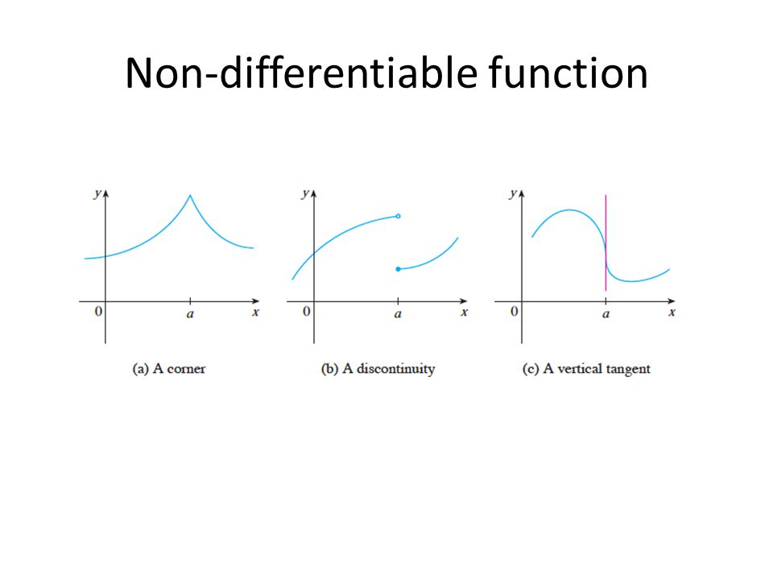
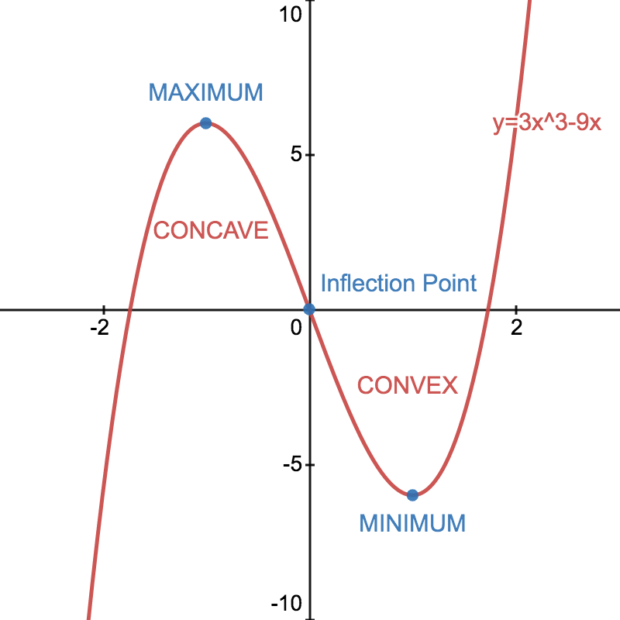
When to use it
Differentiable
Convex Vs Concave

Slide 5
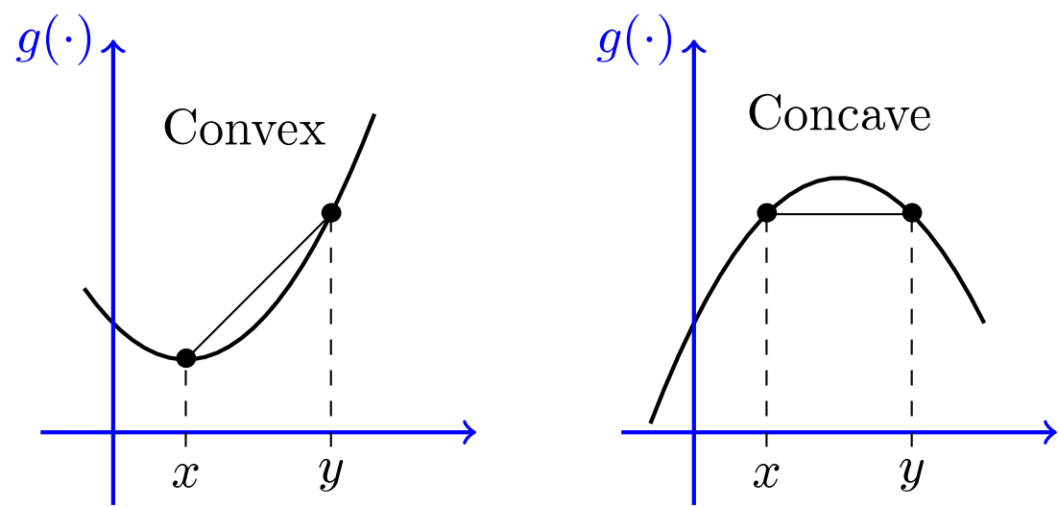
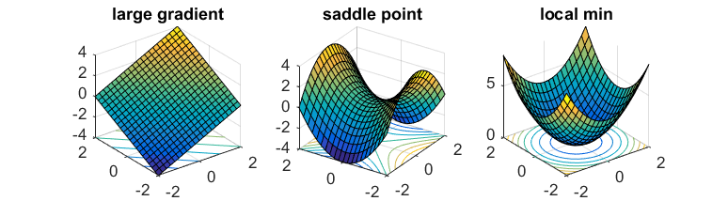
Convex VS Concave (algebraic explanation)
Derivatives
Positive vs Negative
Inflection points
Local maximum and minimum
Saddle points

Slide 6
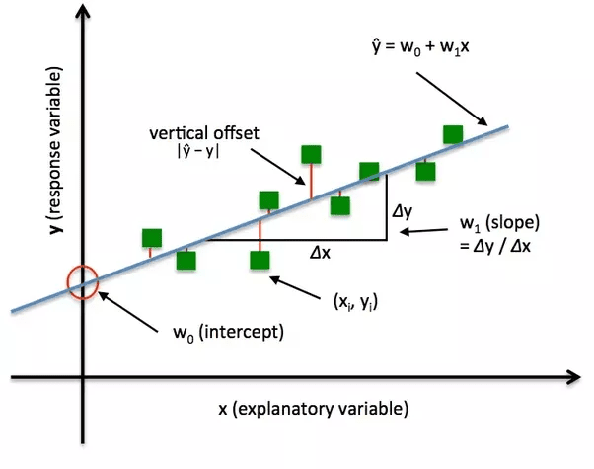
Loss Function
Loss function
Cost function
Notes:
https://deepai.org/machine-learning-glossary-and-terms/loss-function
https://builtin.com/machine-learning/common-loss-functions

Slide 7
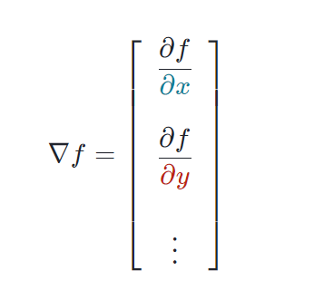
What do the formulas mean?
Partial derivative
Operator
Weights

Slide 8
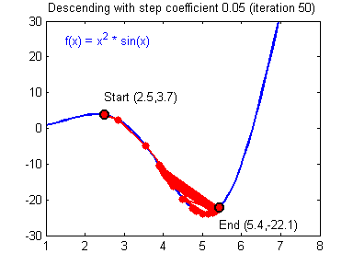
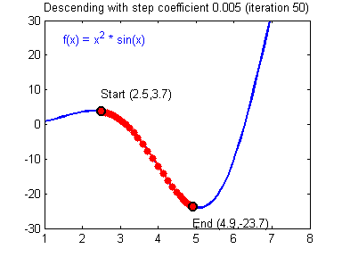
Learning Rate
Step Size = 0.05
Step Size = 0.005

Slide 9
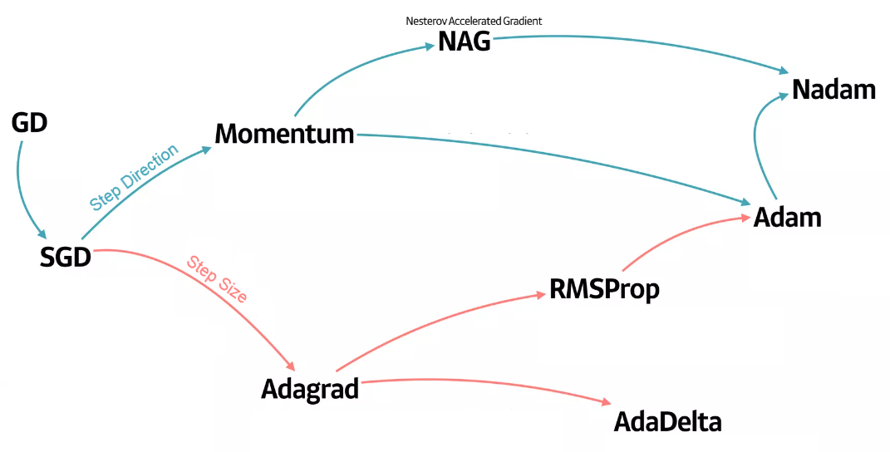
Improving Gradient Descent
Notes:
SGD = Stochastic Gradient Descent = Update the weight from randomly selected data
Momentum = Reflects current direction to the weight
NAG = Similar to momentum, ‘Lookahead Gradient’ added
AdaGrad = Adaptive Gradient
RMSProp = Root Mean Square Propagation

Slide 10
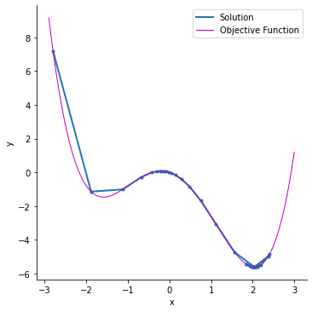
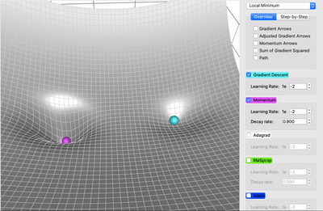
Gradient Descent with Momentum
Create “inertia” to the direction
Less oscillations
Less noisy
Inertia can be an obstacle

Slide 11
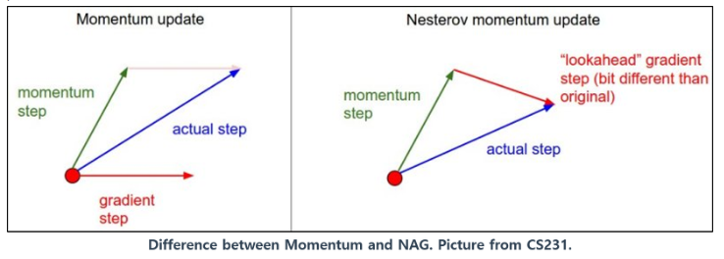
Nesterov Accelerated Gradient (NAG)
Improved version of gradient with momentum
“Lookahead gradient”

Slide 12
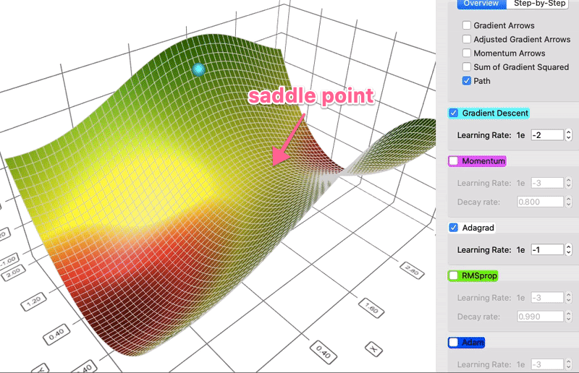
Adaptive Gradient Descent (Adagrad)
Gradient-based Optimization
Learning rate is adapted for each feature

Slide 13
RMSProp / Adam / Nadam
RMS Prop
Root Mean Square Propagation
“Average of squared gradients”
Adam
Momentum + RMSProp
Suitable for very noisy/sparse gradient problems.

Slide 14
Real life example/application
Convolutional neural networks (CNNs)
Notes:
https://www.hindawi.com/journals/cin/2021/6671830/
As a basic technology of deep learning, convolutional neural networks (CNNs) have been widely used in many fields since their inception. CNNs play an important role in fields such as the classification of images [1, 2], the analysis of microexpressions [3], the recognition of faces [4], and the detection of objects [5]. Various improved CNN models have been applied to various images—basic CNN is a supervised learning algorithm. However, CNN’s outstanding image feature extraction ability has related problems [6–8]. This also prompted many scholars to conduct in-depth research. They proposed a method that combines a CNN with an algorithm that provides a classification basis to form an unsupervised learning algorithm such as CSFL, which has broader application prospects

Slide 15
Sources
https://realpython.com/gradient-descent-algorithm-python/
https://towardsdatascience.com/gradient-descent-algorithm-a-deep-dive-cf04e8115f21#:~:text=Gradient%20descent%20(GD)%20is%20an,e.g.%20in%20a%20linear%20regression).
https://www.khanacademy.org/math/multivariable-calculus/applications-of-multivariable-derivatives/optimizing-multivariable-functions/a/what-is-gradient-descent
https://www.khanacademy.org/math/multivariable-calculus/multivariable-derivatives/partial-derivative-and-gradient-articles/a/the-gradient
https://www.hindawi.com/journals/cin/2021/6671830/
https://chat.openai.com/
www.slideshare.net/yongho/ss-79607172?from_action=save
https://towardsdatascience.com/a-visual-explanation-of-gradient-descent-methods-momentum-adagrad-rmsprop-adam-f898b102325c
https://optimization.cbe.cornell.edu/index.php?title=Adam

